Slide 1
PROJECT THREE
Regression and Classification with the Ames Housing Data

Slide 2
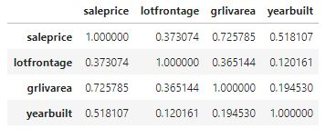
1. Estimating the value of homes from fixed characteristics

Slide 3
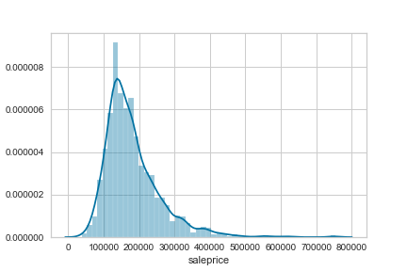
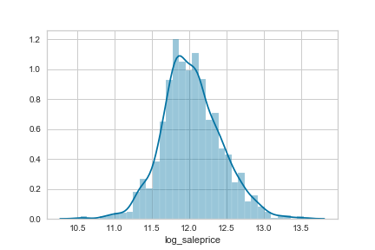
1. Estimating the value of homes from fixed characteristics

Slide 4
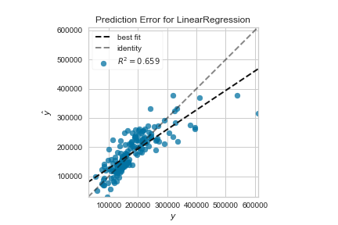
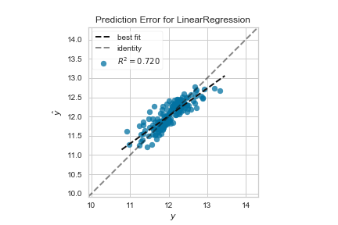
1. Estimating the value of homes from fixed characteristics

Slide 5
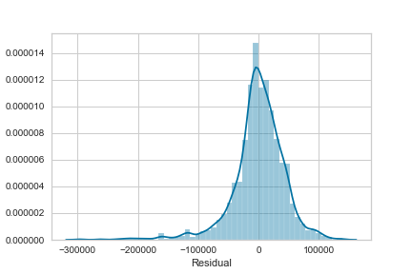
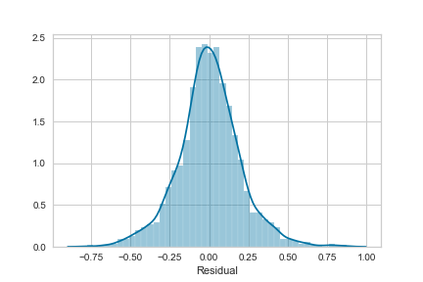
1. Estimating the value of homes from fixed characteristics

Slide 6
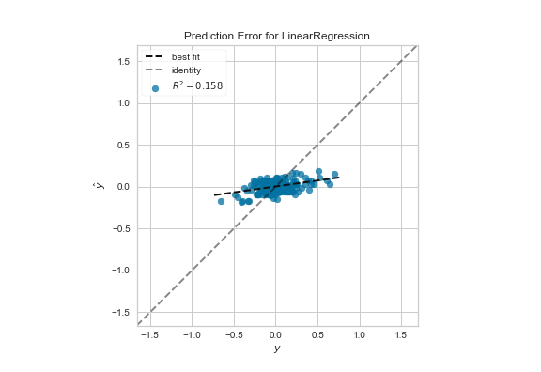
2. Determine any value of changeable property characteristics unexplained by the fixed ones

